Slide 1
NodeXL Installation
https://nodexl.codeplex.com/releases/view/117659
Download “NodeXLBasicExcelTemplate2014Setup.exe”
Install “NodeXL Basic”
Running on Windows only

Slide 2
NodeXL Tutorials
Watch this tutorial
NodeXL Tutorial (part 1 of 3) (9 minutes)
http://www.youtube.com/watch?v=pwsImFyc0lE

Slide 3
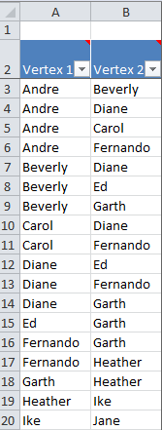
Visualizing Network & Calculating Network Metrics
Kite network example
Vertex (node)
Edge (connection)
Directed edges (w/ arrows)
When sender and receiver must be clearly distinguished
Undirected edges (no arrows)
When simply representing connection (or relationship)
Download Kite.xlsx

Slide 4
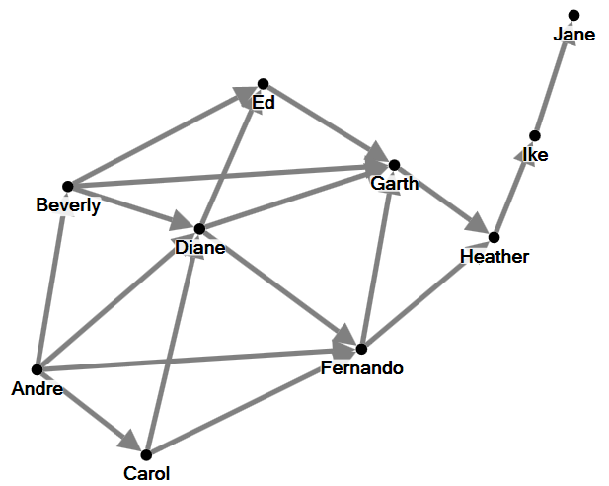
First, Visualizing
Directed graph
E.g., email network
Twitter follower network

Slide 5
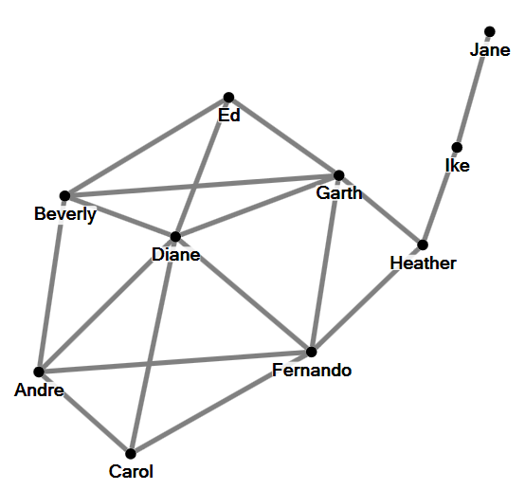
Undirected graph
E.g., friendship network
Co-authorship network

Slide 6
Types of networks
1-degree “Ecocentric” network
A network of your personal facebook friends
You are in the center and others are connected to you
1.5 degree
1 degree network + connections between your friends (everyone is connected to you)
2 degree
1.5 degree network + friends of your friends (some of them are not connected to you)
Full or complete network

Slide 7
Friend
Friend
Ego
Friend
Friend
Friend
Friend
A 1 network
1-degree “Ecocentric” network
Ego
Friend
Friend
A 1.5 network

Slide 8
Friend
Friend
Friend
Friend
Ego
Friend
Friend
Friend
Friend
A 2 network

Slide 9
Second, Calculating Metrics
Two kinds of metrics
1. Vertex or node-level metrics
2. Group or network-level metrics

Slide 10
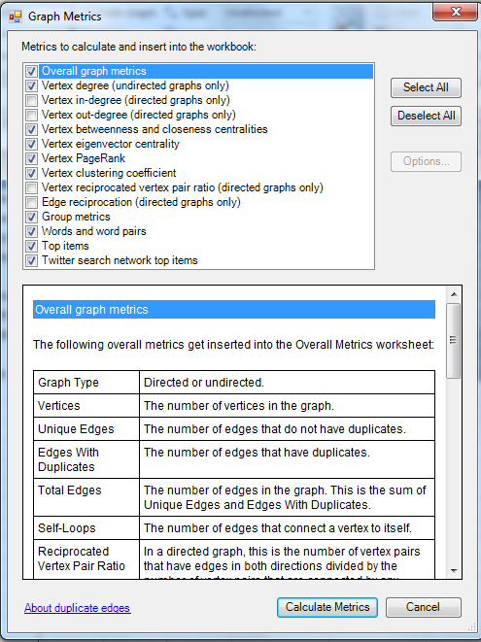

Slide 11
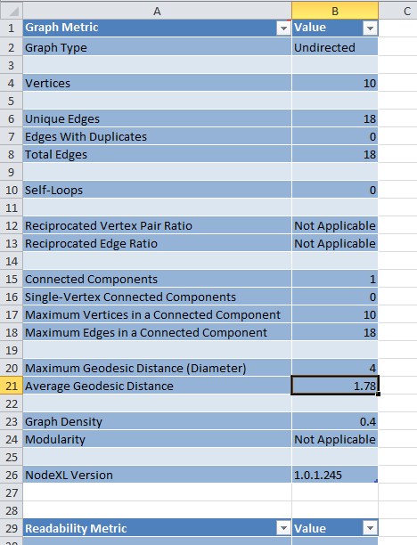

Slide 12
1. Node-level metrics
Degree
In-degree
Out-degree
Degree
Centrality
Betweenness centrality
Closeness centrality
Eigenvector centrality

Slide 13
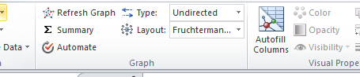
Degree
Diane: the popular person (degree 6)
Garth seems to be popular (in-degree 4)
Jane: the least popular
Download Kites.xlsx and load it on NodeXL

Slide 14
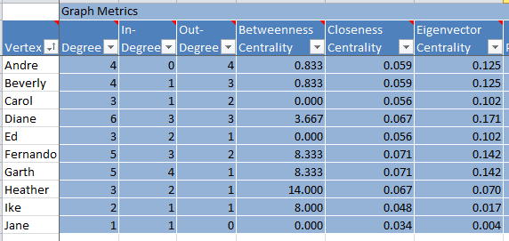

Slide 15
Betweenness centrality
A measure of how often a given node lies on the shortest path between two other nodes
Nodes in the shortest paths of other nodes have a higher BC
Nodes with high BC are important in terms of communication
“Bridges”

Slide 16
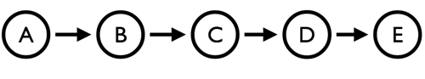
Betweenness centrality
Directed graph
A -> B: None
A -> C: B
A -> D: B, C
A -> E: B, C, D
B -> C: None
B -> D: C
B -> E: C, D
C -> D: None
C -> E: D
D -> E: None
Standardized = BC / (n-1)(n-2)
Node | BC | Standardized
A | 0 | 0
B | 3 | 0.25
C | 4 | 0.333333
D | 3 | 0.25
E | 0 | 0
http://www.markhneedham.com/blog/2013/07/19/graph-processing-calculating-betweenness-centrality-for-an-undirected-graph-using-graphstream/

Slide 17
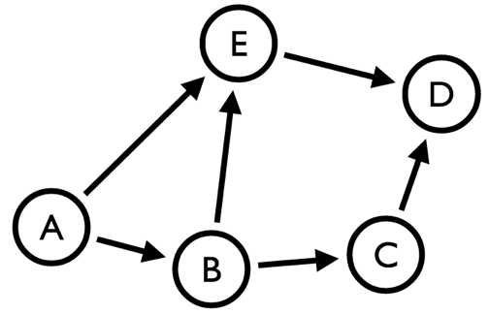
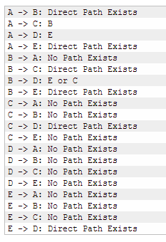
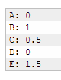
Shortest paths
Betweenness Centrality
http://www.markhneedham.com/blog/2013/07/19/graph-processing-calculating-betweenness-centrality-for-an-undirected-graph-using-graphstream/

Slide 18
Betweenness centrality
Heather: only 3 degree, but … like a “bridge” … high betweenness centrality …
What about Ed, Carol and Jane?
Removing them causes anything?

Slide 19
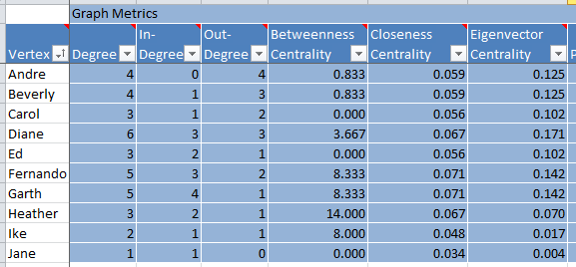
In general, high-degree nodes have high BC
Every shortest path between
Jane and the other nodes (8 of them)
contains Ike. Thus, BC = 8

Slide 20
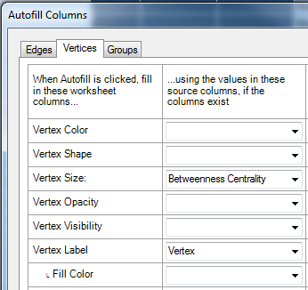
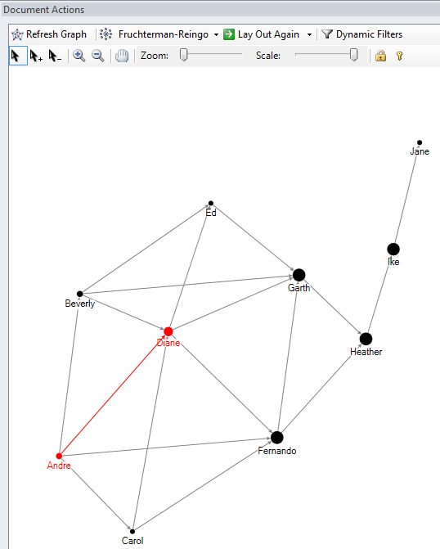

Slide 21
Closeness centrality
The average shortest distance from one node to the rest
Garth & Fernado: information can spread quite fast from them
“Kevin Bacon”

Slide 22
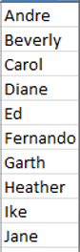
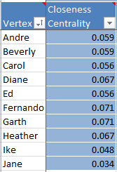
Distance between Diane and others Shortest path
1
1
1
0
1
1
1
2
3
4
Total 15 distances
The inverse of 15
= (15)⁻¹
= 0.067

Slide 23
Eisenvector Centrality
A connection to a popular node means more than that to a loner
Ed: 4 + 6 + 5 = 15
Heather: 2 + 5 + 5 = 12
So, Ed is more important …

Slide 24
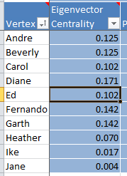

Slide 25
2. Network-level metrics
Clustering efficient
Average geodesic distance
Graph density
Modularity
Etc …

Slide 26
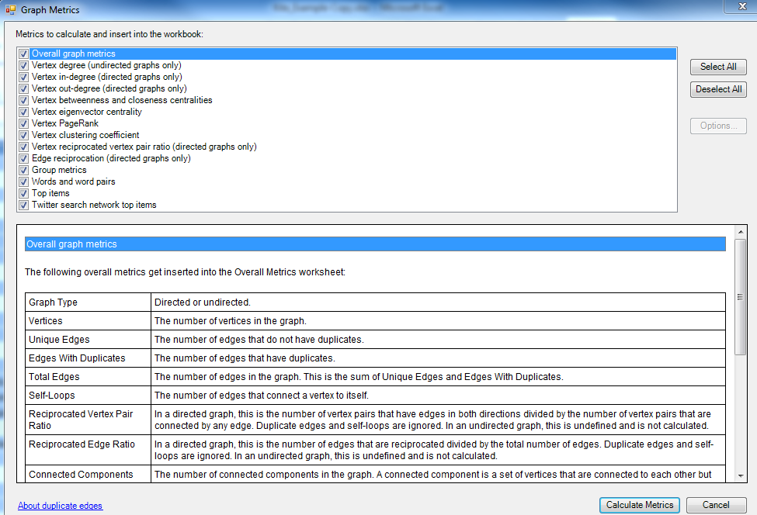
You can explore more
Definitions of overall graph metrics here …

Slide 27
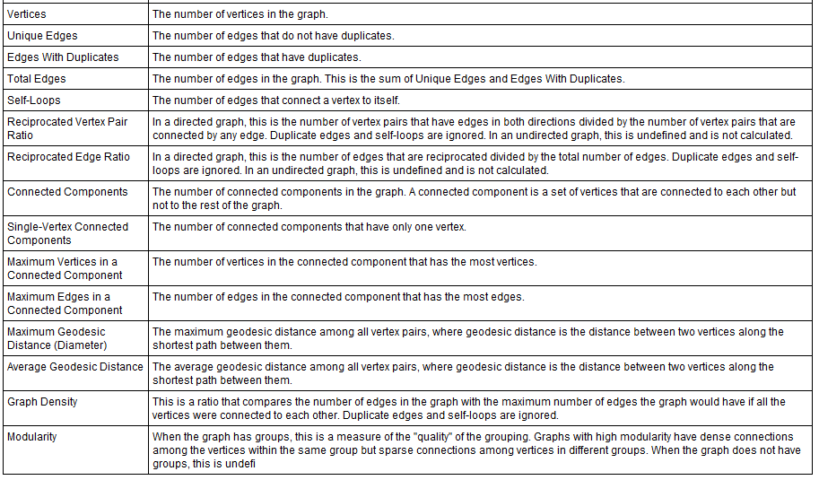

Slide 28
Clustering coefficient
A clique or complete graph: all nodes are directly connected.
How connected a node’s neighbors are to one another
Heather’s clustering coefficient?

Slide 29
What is clustering coefficient of Heather?
How many edges may there be between Heather’s friends? 3
How many edges are there between Heather’s friends? 1 (Garth-Fernando)
Clustering coefficient: 1/3

Slide 30
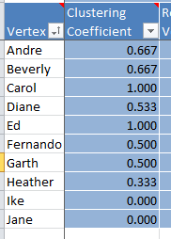

Slide 31
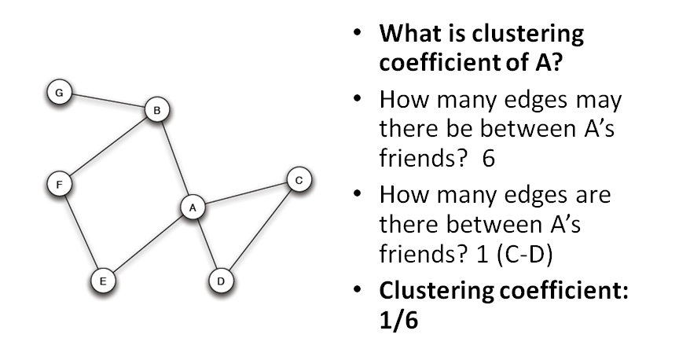
Quiz

Slide 32
Average geodesic distance
Geodesic distance: distance (or number of edges) between nodes
AGD: Average of all geodesic distances
Low AGD ➔ nodes are directly connected
High AGD ➔ nodes are not knowing each other directly (but may be through their friends)

Slide 33
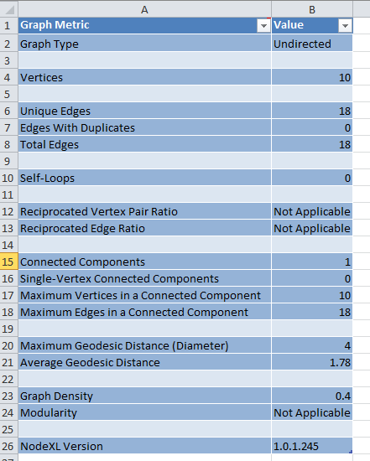
Small-world network

Slide 34
Graph density
Between 0 and 1
How connected are nodes in a network?
18 actual edges & 45 possible edges … So graph density is 0.4
0.8 would mean “very dense graph”
0.1 would mean “very sparse graph”
Node1 | Node2 | Node3 | Node4 | Node5 | Node6 | Node7 | Node8 | Node9
9 | 8 | 7 | 6 | 5 | 4 | 3 | 2 | 1 | Total 45

Slide 35
Advanced Topic Clustering & Grouping

Slide 36
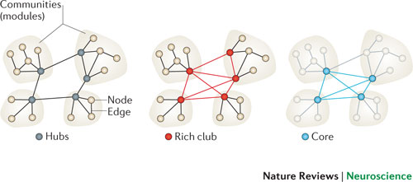
Clustering or Modularity Analysis
Networks contain sub-networks (clusters or modules)
Networks are hierarchical
A cluster is a group of nodes with tight connection

Slide 37
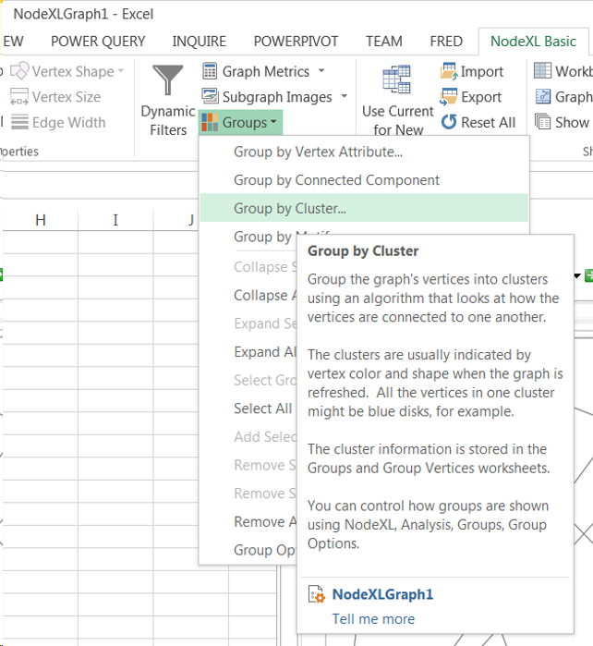

Slide 38
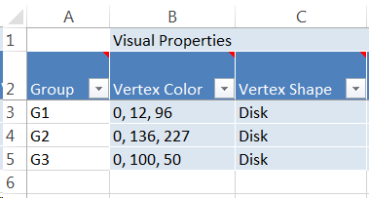
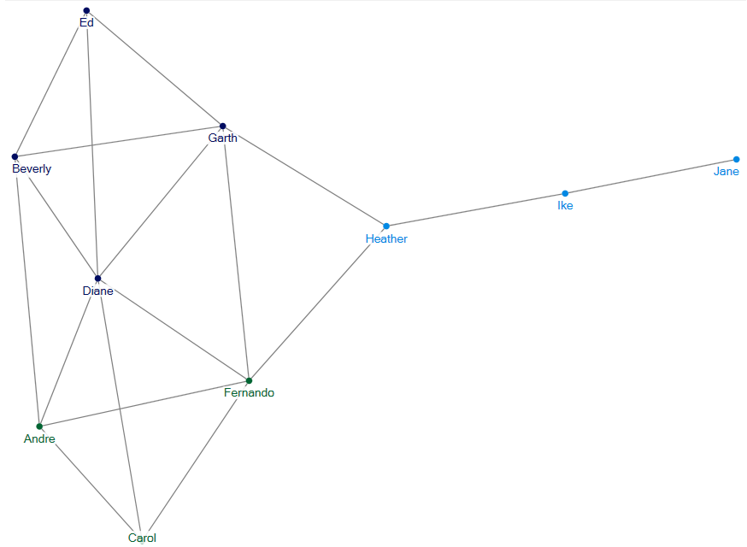
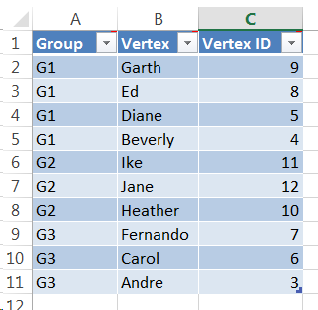

Slide 39
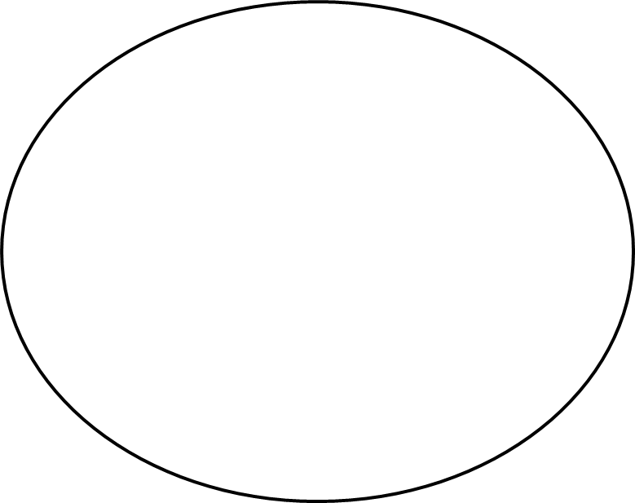

Slide 40
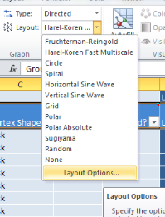
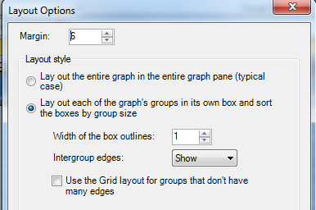
This puts clusters of nodes in its own box

Slide 41
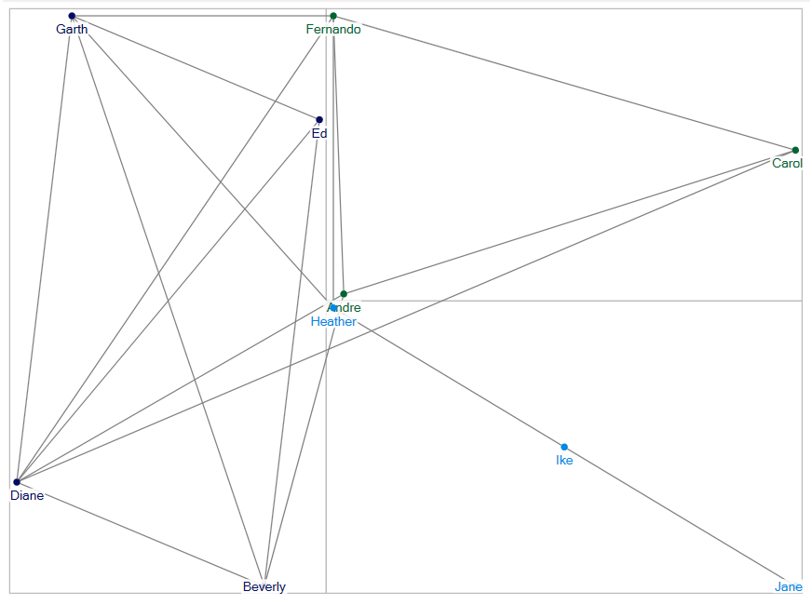

Slide 42
An Example of clustering analysis The 2007 senate voting analysis

Slide 43
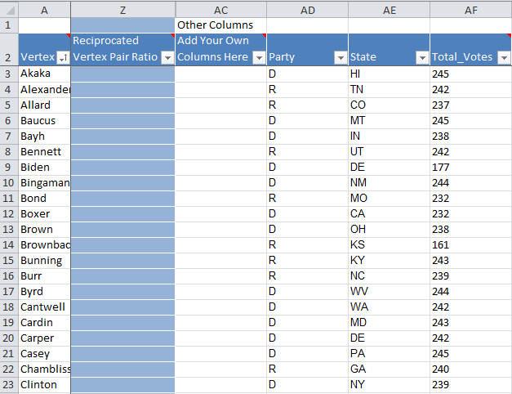
Open another instance of NodeXL for this new dataset
Download Senate.xlsx

Slide 44
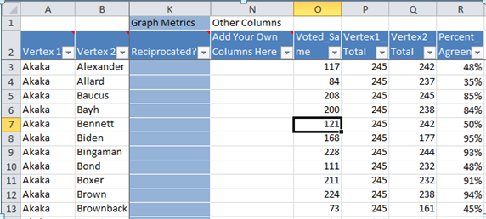
Senators Akaka (D, Hawaii) and Allard (R, Colorado) voted the same 84 times (35% of the time)
Senators Akaka and Baucus (D. Montana) voted the same 208 times (85%)
Two democrats are “closer” than with a republican …

Slide 45
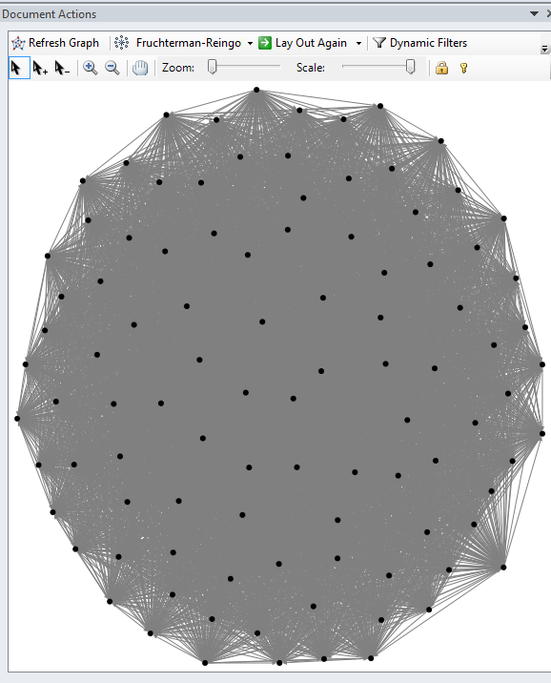
Network looks like this …
Every senator may have voted the same with every other senator at least once
So … let’s try something else to draw meaningful information

Slide 46
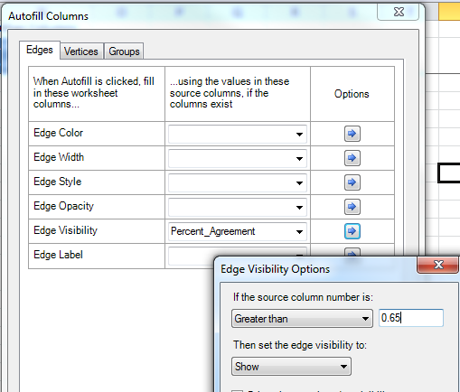
Let’s see the edges of those who voted the same over 65% of the time
Do not show the rest below 65% of the time

Slide 47
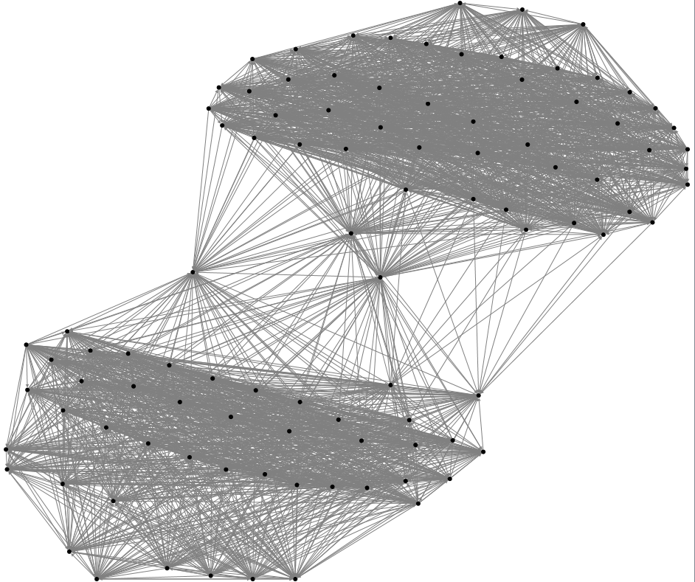
Bi-partisan

Slide 48
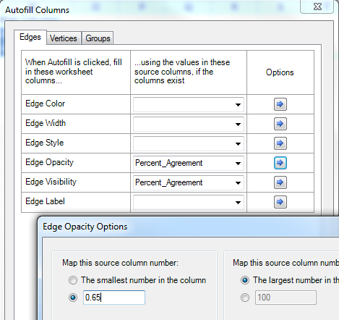
Edge opacity improves the appearance of dense graphs: Change it to something smaller than the default value of 10 and all the edges will become semitransparent
Let’s see the edges of those who voted the same over 65% of the time
Do not show the rest below 65% of the time

Slide 49
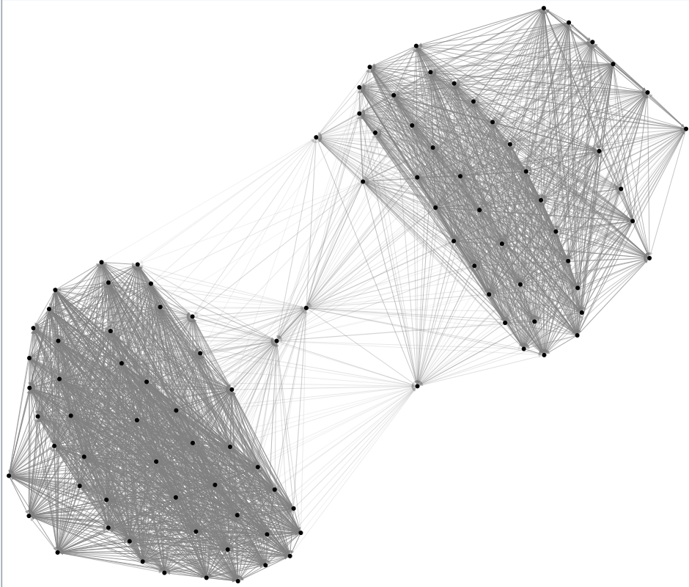
Edges look more transparent
Better appearance!

Slide 50
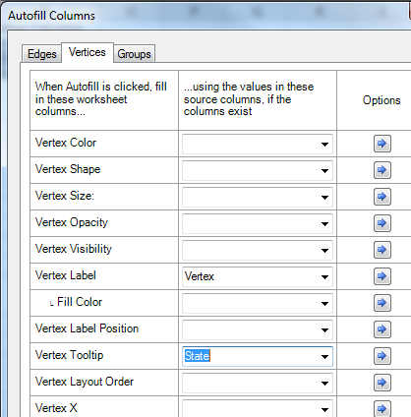

Slide 51
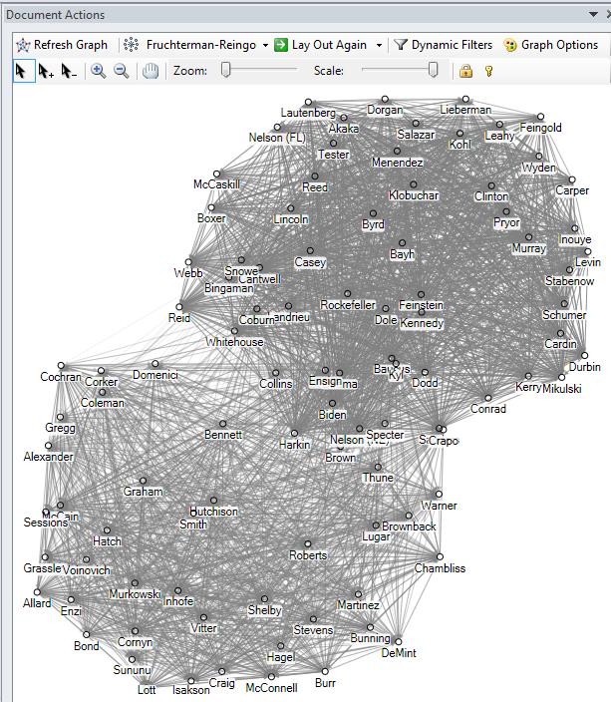
Do you see clusters?

Slide 52
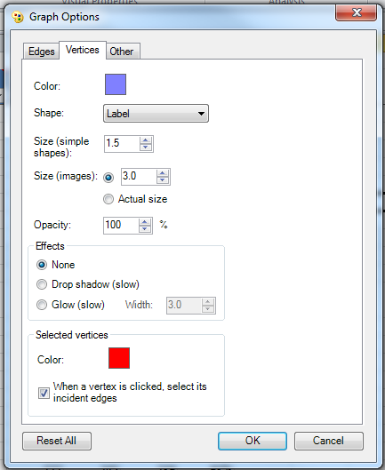

Slide 53
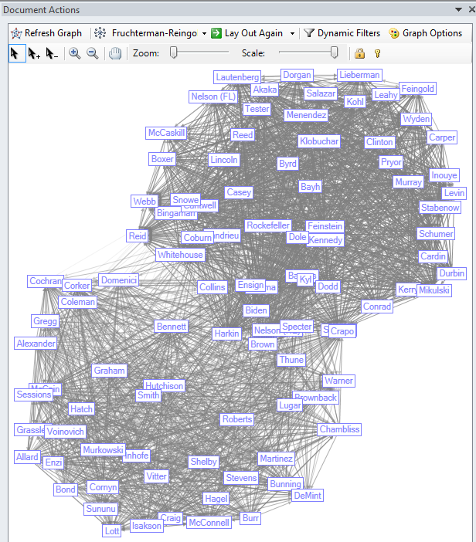

Slide 54
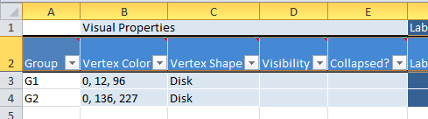
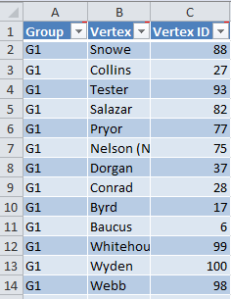
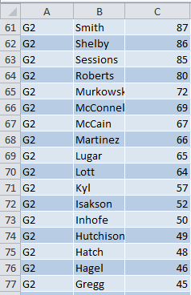
Try “Group by Cluster” in Analysis

Slide 55
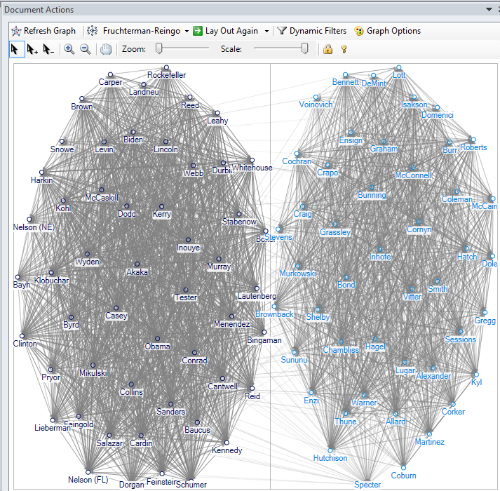
Refresh the graph

Slide 56
HW
Les Miserables movie dataset
Network analytics of actors/actresses of the movie
Goal: To master network analytics techniques & tools
Finding out who is influential
Finding out how people are connected to each other?
Finding out what clusters exist

Slide 57

Example: Les Miserables
https://www.youtube.com/watch?feature=player_embedded&v=YmvHzCLP6ug

Slide 58
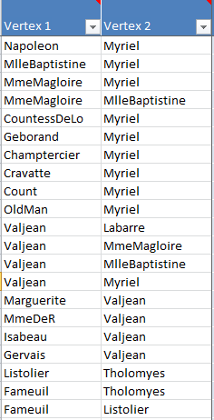
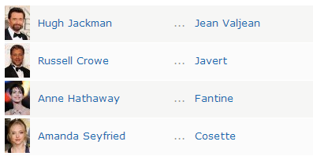
Les Miserables Co-Appearance Network
Open another instance of NodeXL for this new dataset
Connecting characters who appear together in a scene in the book
Who do you think are important characters in the book?
http://www.imdb.com/title/tt1707386/fullcredits/

Slide 59
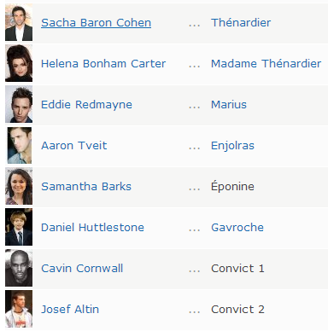
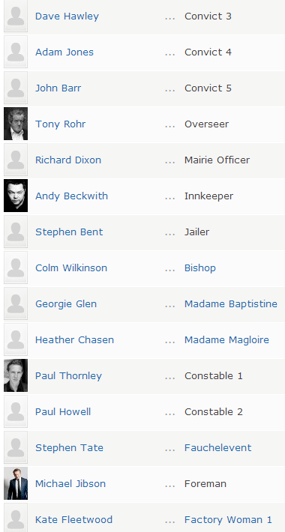
http://www.imdb.com/title/tt1707386/fullcredits/

Slide 60


Slide 61


Slide 62

Using Edge Weight as Edge Width

Slide 63


Slide 64


Slide 65

Example: Les Miserables
Small-world network

Slide 66

Les Miserables

Slide 67


Slide 68

My

Slide 69
Gavroche - highest Eigenvector centrality (0.318)
A young street urchin who acts as an unofficial courier
linking many other characters together
Myriel (priest) – a relatively low degree, but high betweenness centrality
He is the only link to seven other nodes
A group of student rebels shows the high Clustering Coefficient of 0.927
(forming a dense cluster)
Student rebels rarely show up with characters other than themselves
Marius is the clear exception, which is what drives his high degree and betweenness centrality
Gavroche’s direct connection to the student group and other key characters is also what drives his high Eigenvector Centrality

Slide 70


